Slide 1


JIRA: Powering Agile Project Management
JIRA is a versatile project management tool by Atlassian. It excels in issue tracking and supports agile methodologies. Teams use JIRA to plan, track, and manage software development efficiently.
by DINESHRAJ DHANAPATHY

Slide 2

Key Features of JIRA
1
Issue Tracking
Manage bugs, tasks, and work items effectively.
2
Agile Support
Facilitate Scrum and Kanban methodologies for sprints and tasks.
3
Custom Workflows
Define unique processes with customizable states and transitions.
4
Reporting
Track progress with built-in reports and custom dashboards.

Slide 3

JIRA Components
1
Project
Container for related issues with configurable workflows and permissions.
2
Issue
Core item representing tasks, bugs, or user stories.
3
Sprint
Time-boxed period for completing a set of work.
4
Board
Visual representation of work items, including Scrum and Kanban boards.

Slide 4




Key JIRA Agile Concepts
Backlog
Prioritized list of tasks and stories for future sprints.
Sprint Planning
Meeting to select backlog items for the upcoming sprint.
Burndown Chart
Visual representation of work left in the sprint.

Slide 5
JIRA for Agile Methodologies
Scrum in JIRA
Kanban in JIRA
Organize work into sprints using Scrum boards. Plan sprints and groom the backlog.
Visualize tasks on a continuous flow board. Set WIP limits to prevent bottlenecks.

Slide 6
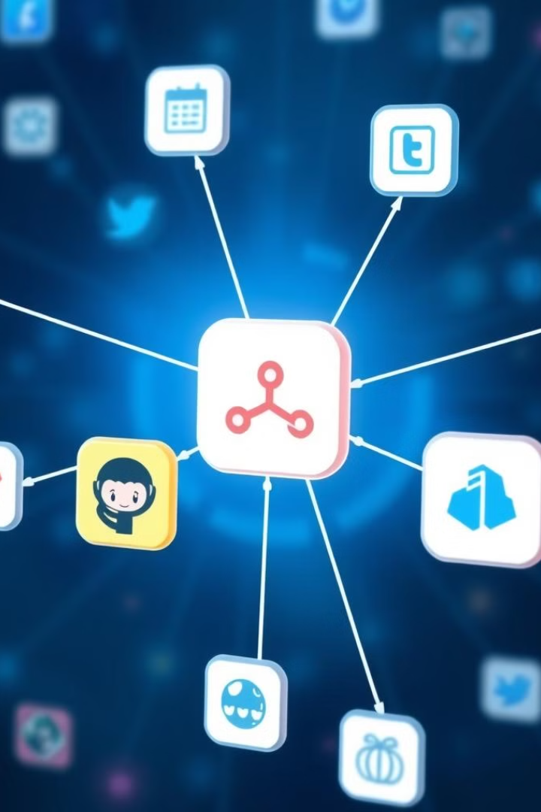

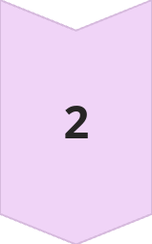
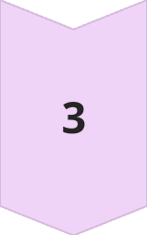
Integration with Other Tools
Confluence
Link JIRA issues to Confluence pages for detailed documentation.
Bitbucket/GitHub
Connect code commits and pull requests to JIRA issues.
Jenkins
Automate build and deployment processes, tracking status in JIRA.

Slide 7
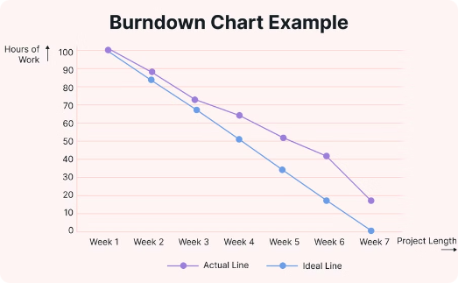
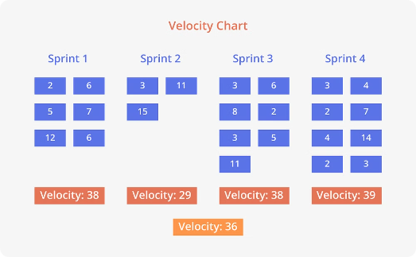
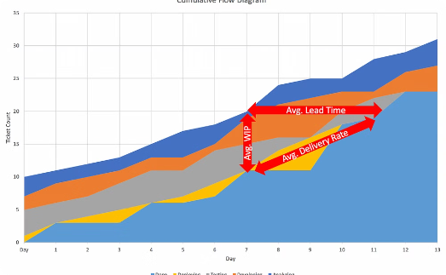
JIRA Reporting
Burndown Chart
Velocity Chart
Cumulative Flow Diagram
Tracks remaining work and progress over time in a sprint.
Shows work completed in each sprint, helping forecast future capacity.
Visualizes workflow stages over time, showing task distribution.

Slide 8

Best Practices for JIRA
Clear Workflows
Customize workflows to match project needs and ensure team understanding.
Organize Issues
Use labels and components to categorize and manage issues efficiently.
Regular Grooming
Keep the backlog clean and prioritized through regular reviews.
Leverage Automation
Use automation rules to handle repetitive tasks and transitions.

Slide 9

Advantages of JIRA
1
Scalability
Suitable for teams of all sizes, from startups to large enterprises.
2
Customization
Flexible workflows adaptable to different teams and projects.
3
Agile Support
Excellent tools for Scrum and Kanban methodologies.
4
Integration
Seamless connection with various development and collaboration tools.

Slide 10

Disadvantages of JIRA
Complexity
Can be overwhelming for new users or small teams
Learning Curve
Customization requires good understanding of JIRA settings
Pricing
Costs can add up quickly for larger teams using premium features

Slide 11

Conclusion: JIRA is a Powerful Project Management Tool
JIRA is a versatile and powerful tool for project management, issue tracking, and agile development. Its robust feature set allows teams to collaborate, track progress, and manage workflows efficiently. Whether you're running a small team or managing large-scale enterprise projects, JIRA can adapt to your needs and provide valuable insights into your work progress.

